Slide 1
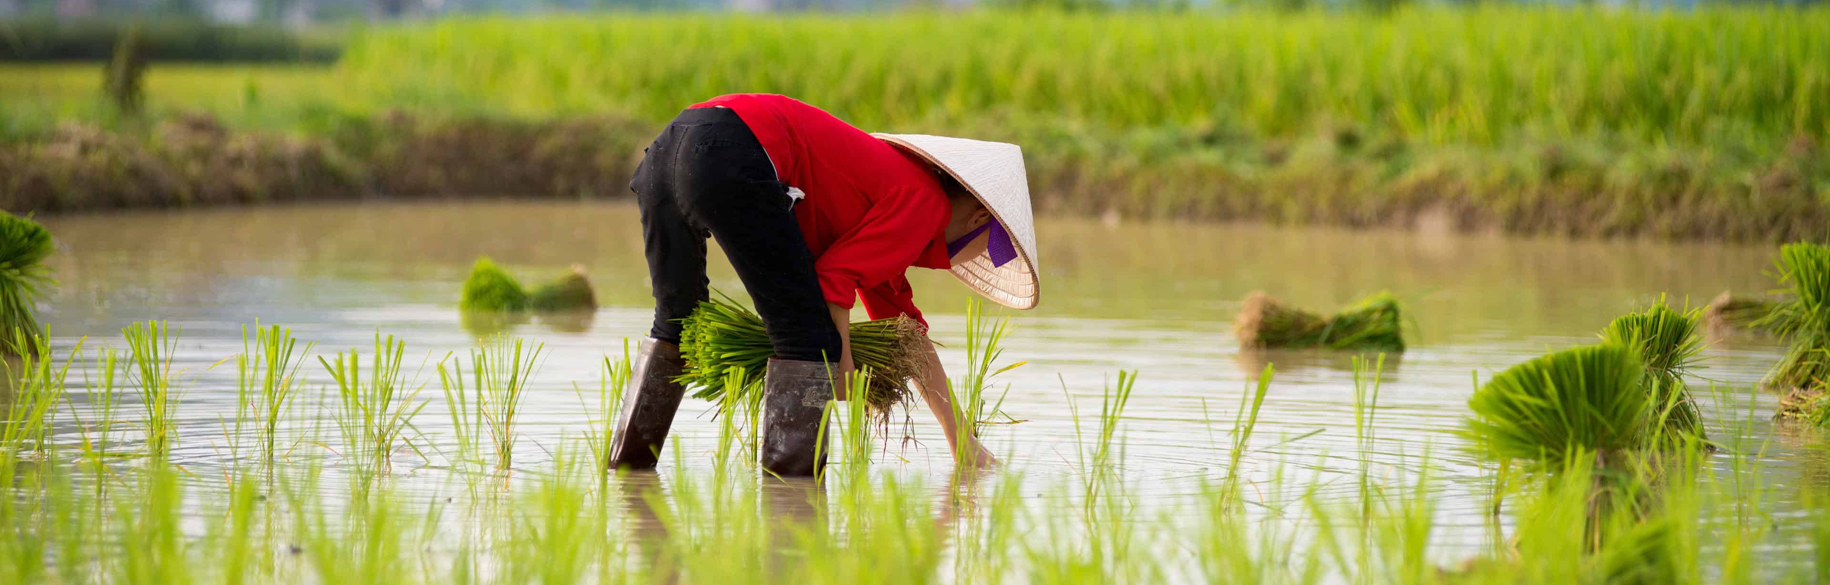

Sustainable Rice Farm Management For Smallholder Farmers in Indonesia
Source: Rice Farm Wallpapers - Wallpaper Cave
Noviria Syifaun Nafsi, Sineenad Kongtonkun, Inkyin May, Vani Lian
Module: Decision Analysis and Forecasting Agriculture
Summer semester 2023

Slide 2
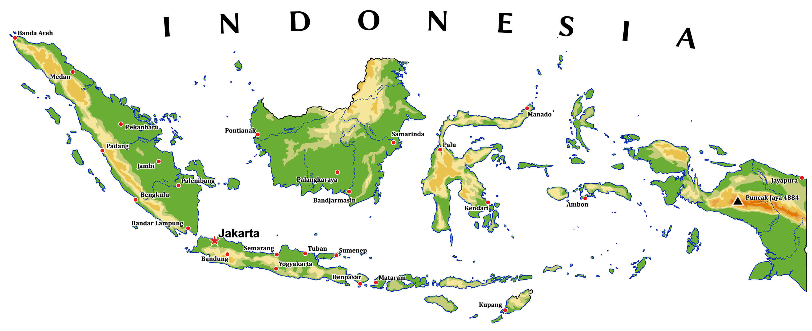
Overview
Rice is the primary staple food crop with a steady increase in annual production, making Indonesia the third largest rice producer in the world.
93% of Indonesia’s total number of farmers are small family farms.
Sustainable Rice Farm Management For Smallholder Farmers in Indonesia

Slide 3
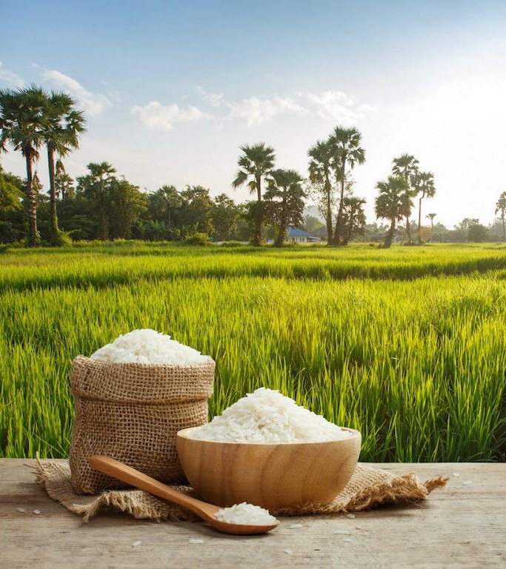
Outcomes
Smallholder farmers can be more aware of the effect of their farms to climate change by emitting less GHG emission from their farms.
1
Smallholder farmer can be more resilient in dealing with the impact and of climate change to their farm.
2
Better farming practices and management can be implemented by the Indonesian rice smallholder farmers.
3
Land fertility can be maintained or even improved for better rice production in the long-term.
4
Source: Rice Farm Wallpapers - Wallpaper Cave
Sustainable Rice Farm Management For Smallholder Farmers in Indonesia

Slide 4
Baseline comparison
Decision + decision maker
Rice cultivation with crop rotation
Conventional rice farming cultivation
Time span + quantification of NPV
10 years
The unit of Net Profit Value (NPV)
IDR
NPV calculation

Slide 5
Conceptual model
Organic rice farming
Management cost
Maintenance costs
Total cost
Sustainable rice farming management
Net Present Value (NPV)
Rice yield
Additional yield from other crops (soybean and chili)
Soil fertility (%SOM)
High nutrition value
Crop rotation
Revenue
Crop failure risk (rice, soybean and chili)
GHG emission rate (%CH4)
Fluctuate commodity price
Decisions
Negative influences
Estimated variables
Positive influences
Calculated variables
Source: Rice Farm Wallpapers - Wallpaper Cave
Sustainable Rice Farm Management For Smallholder Farmers in Indonesia

Slide 6
Management cost
Model
Labour
Economics
Seeds
Fertilitizer
Income
Maintanace cost
Harveting
Machine
Prices
Yields
Growing
Caring
Harvesting
Sustainability Rice Farm
Lost yield for harvest
Organics
Yield
Environmental
Eco-friendly
Crop rotation
Fertilizer
Soil nutrition

Slide 7
Variable
Input
Action
Outcome
Price of seeds
Price of fertilizer
Price of pesticide
Cost of labor
Cost of machinery
Organic rice farming
Crop rotation
Training for farmer
Yield of rice and other crops
Additional income from other crops
Maintain/improve soil fertility
Goal & Impact (long-term)
Eco-friendly farm: soil fertility and less emission
Higher/stable income for farmers

Slide 8
NPV calculation

